Slide 1
Mechanics of Filaments & Networks

Slide 2
Persistence Length
How can we quantifiy the ‚stiffness‘ of a polymer?
Stiffness is scale dependent!
Long rod: flexible
Short rod: stiff
A good measure for stifness is the length scale, over which the polymer/rod can be considered ‚stiff‘: persistence length

Slide 3
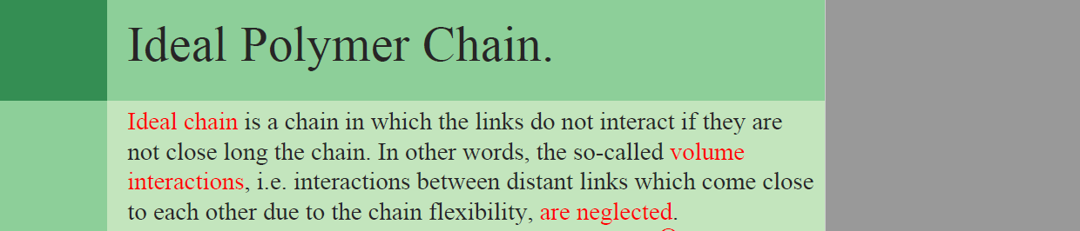
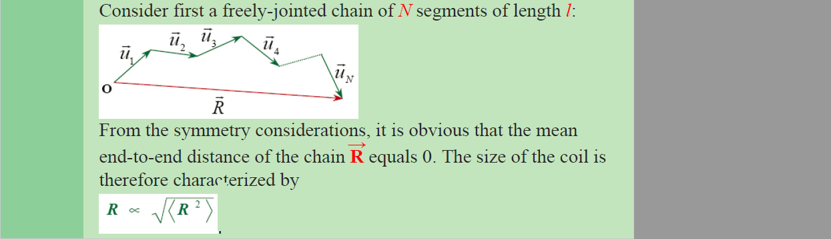
Random walk

Slide 4
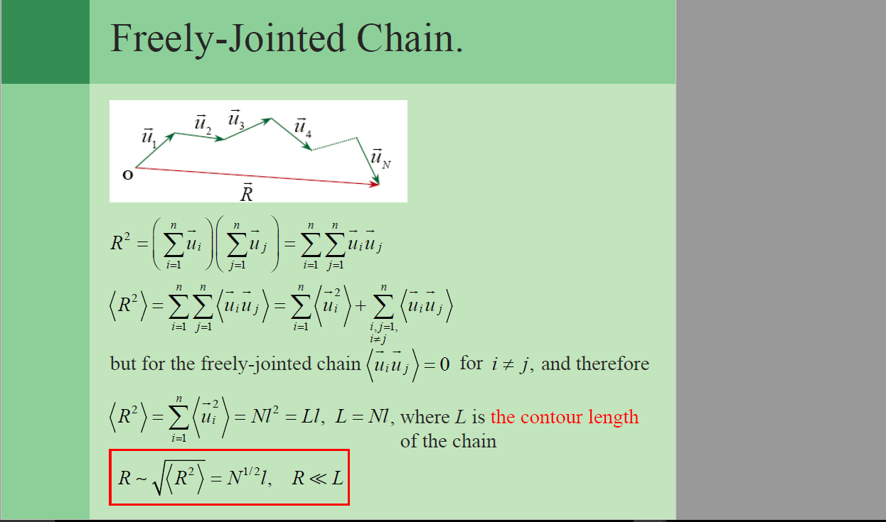

Slide 5
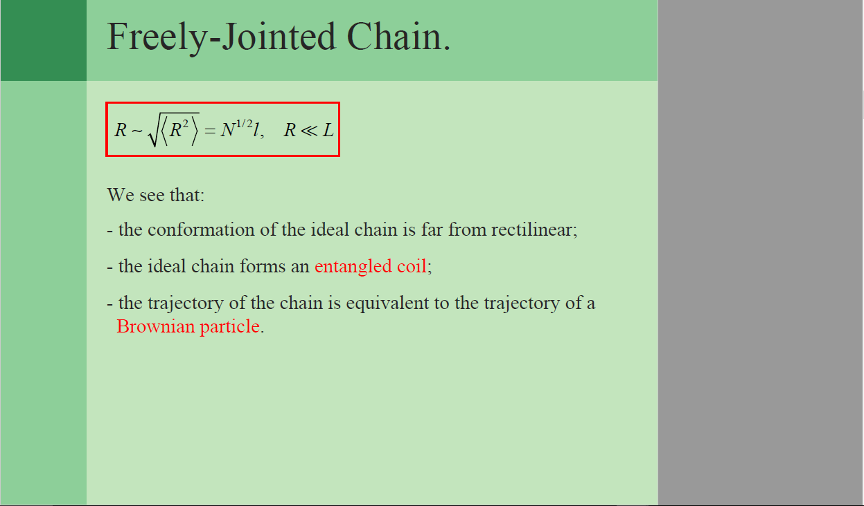

Slide 6
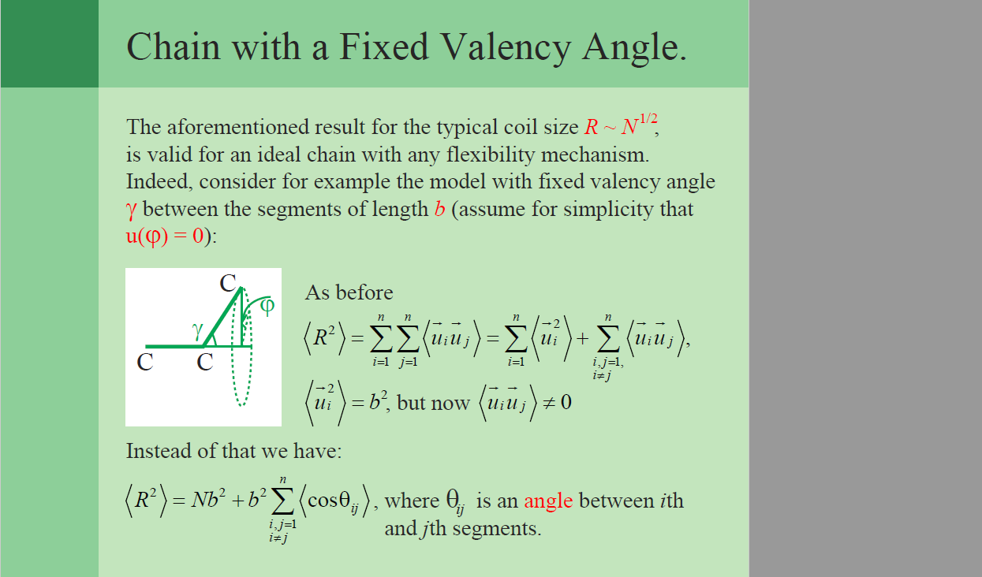

Slide 7
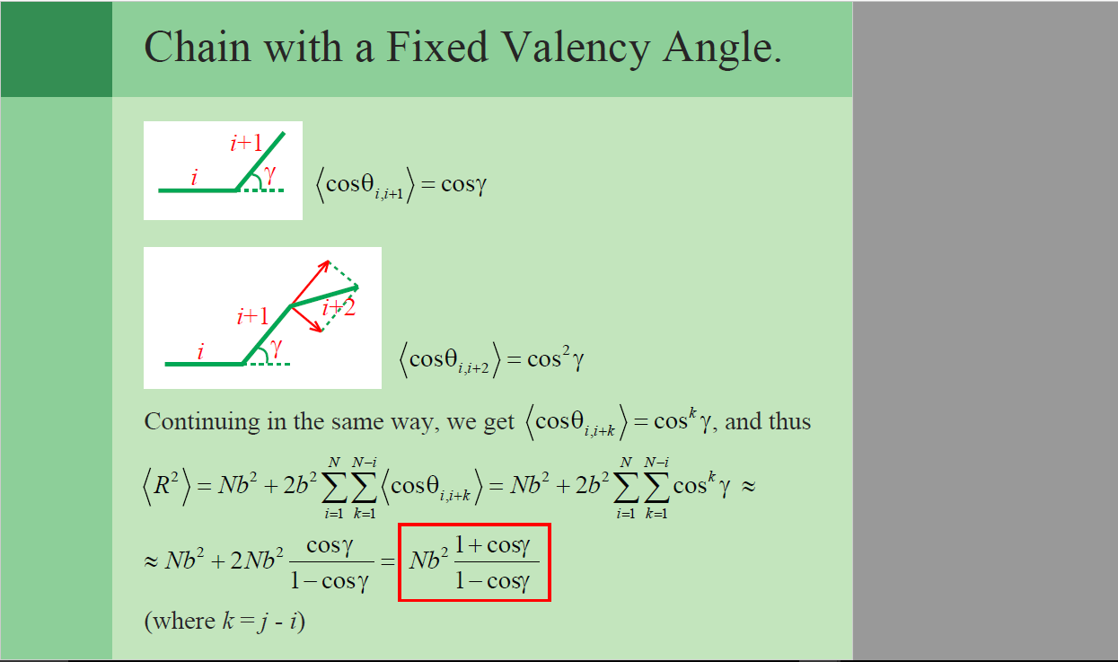

Slide 8
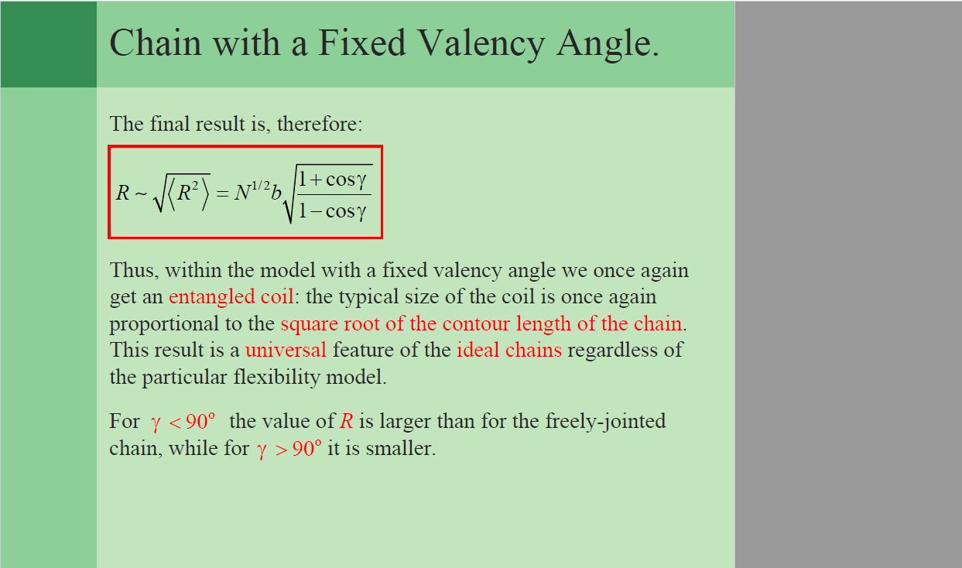

Slide 9
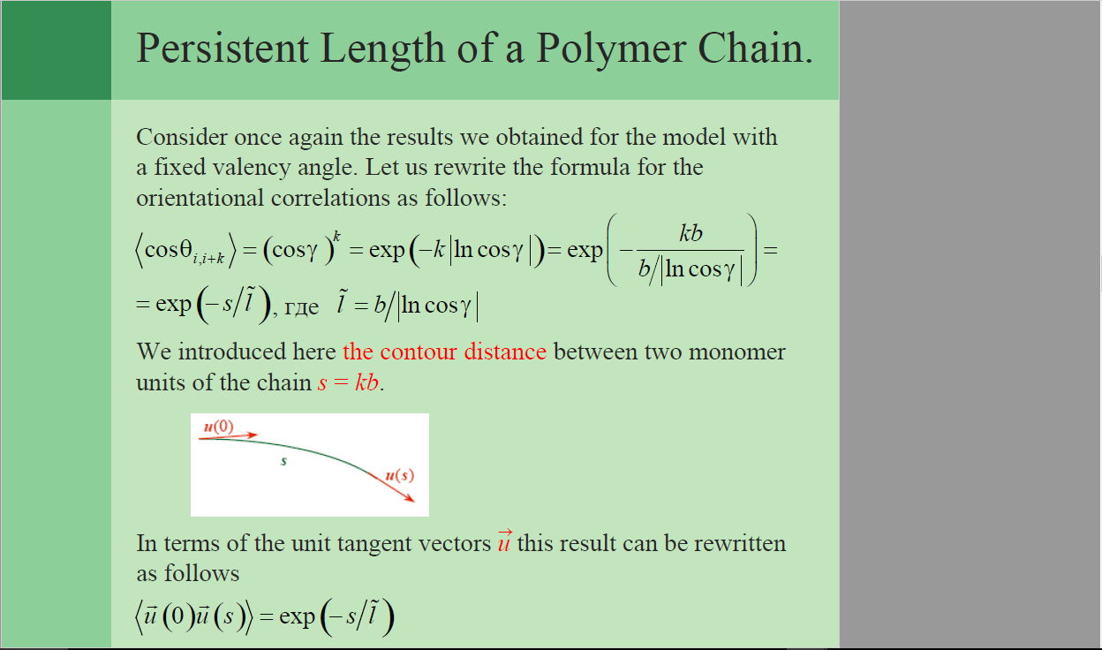

Slide 10
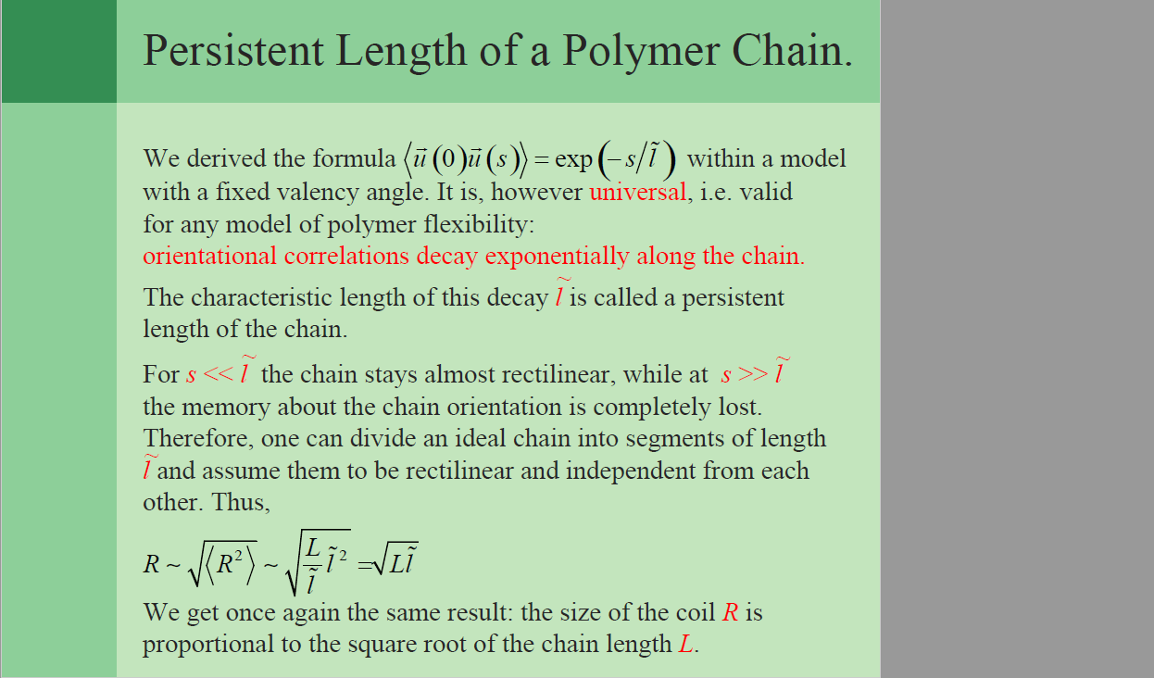

Slide 11
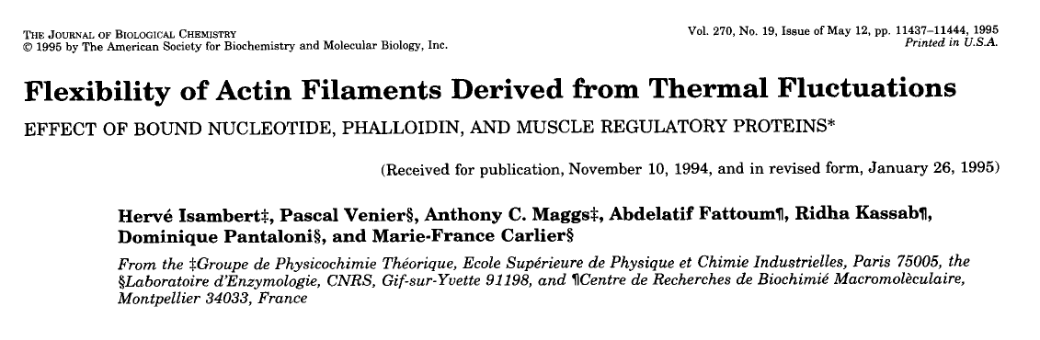

Slide 12
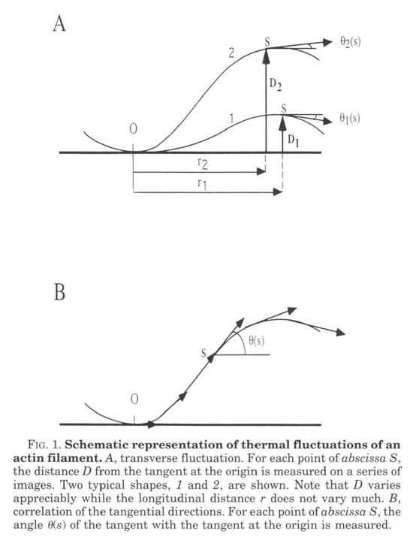
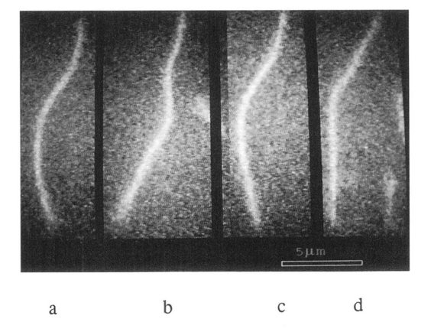

Slide 13
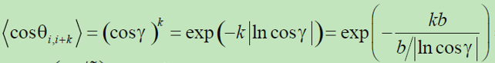
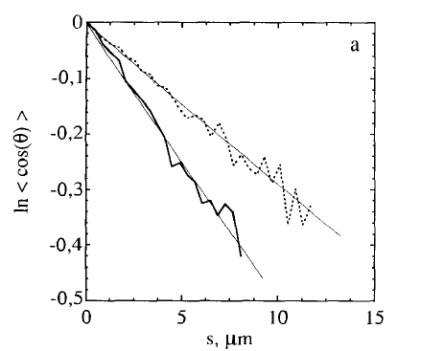
cosine-correlation

Slide 14
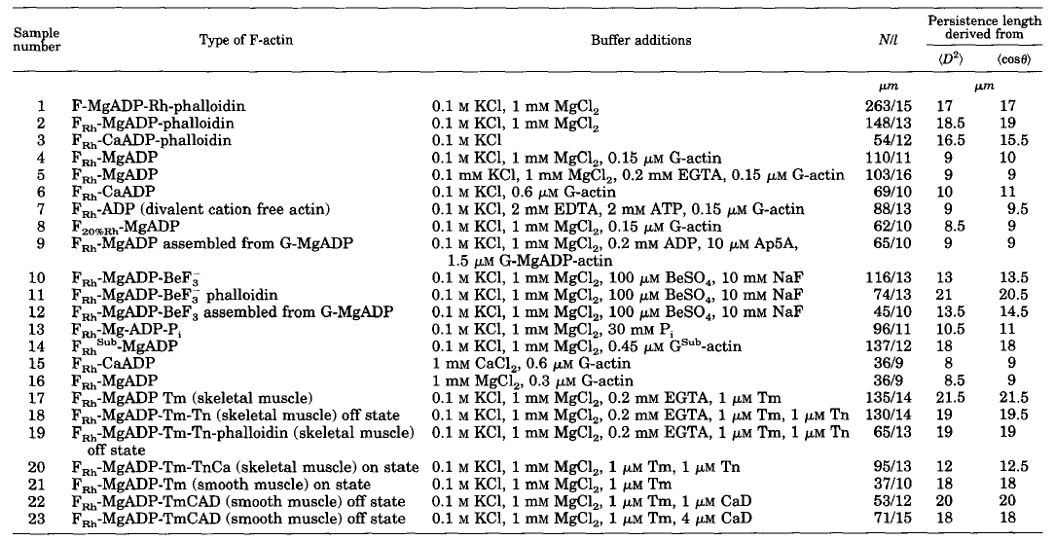
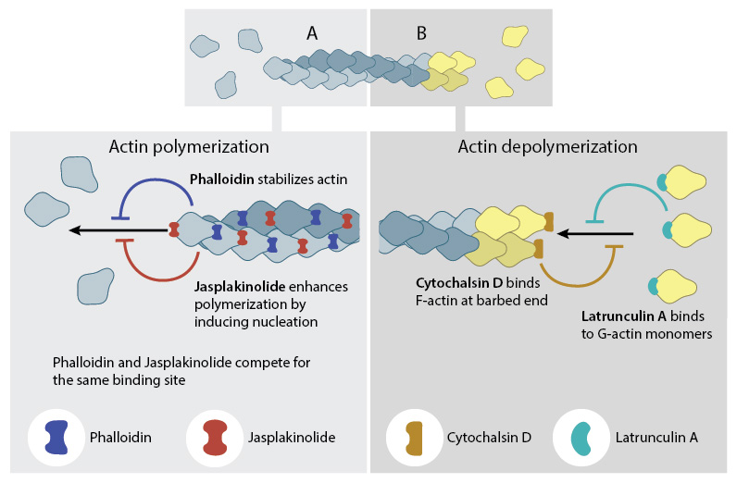
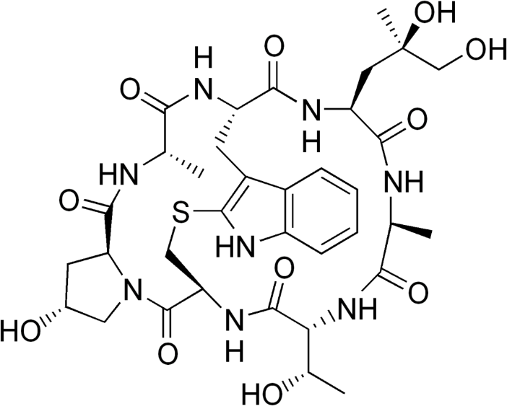
Phaloidin: toxin from fungi

Slide 15
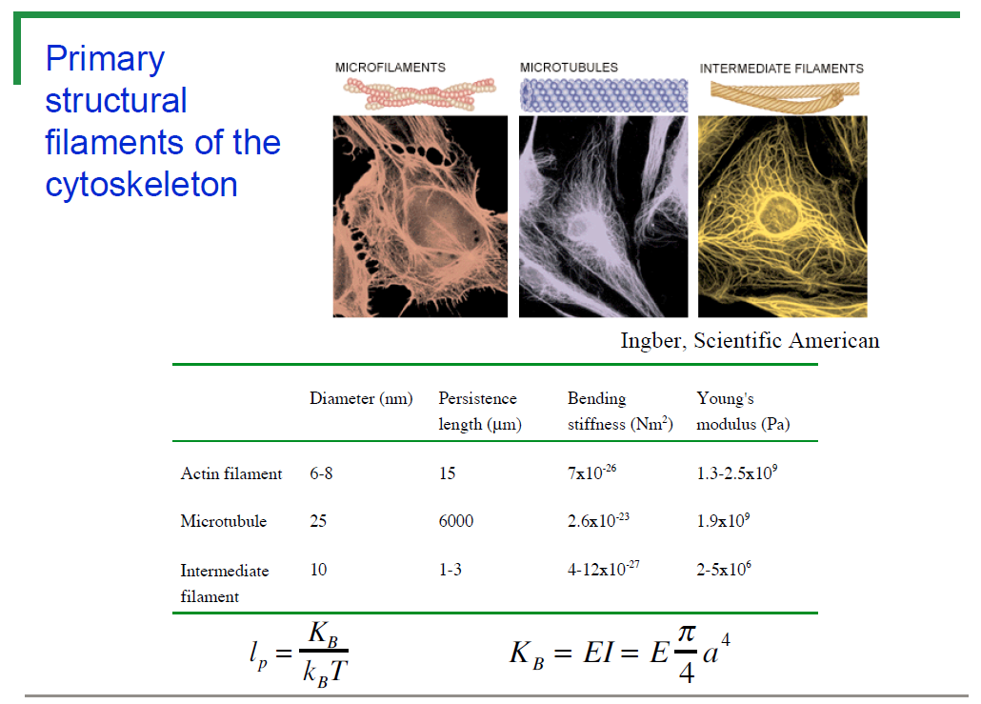
K_{B}: Bending stiffness
E: Young‘s modulus (elastic modulus)
I: Moment of inertia of the crosssection

Slide 16
Introduction to theory of elasticity
Deformation & Young‘s Modulus

Slide 17
ELASTIC DEFORMATION
1. Initial
2. Small load
3. Unload
Elastic means reversible!
2

Slide 18
PLASTIC DEFORMATION (METALS)
1. Initial
2. Small load
3. Unload
Plastic means permanent!
3

Slide 19
Recoverable
Instantaneous
Elastic
Time dependent
Anelasticity
Deformation
Instantaneous
Plastic
Permanent
Time dependent
Viscoelasticity

Slide 20
Elasticity
Elastic deformation is reversible deformation- i.e. when load/forces/constraints are released the body returns to its original configuration (shape and size).
Elastic deformation can be caused by tension/compression or shear forces.
Usually in metals and ceramics elastic deformation is seen at low strains (less than ~10^{–3}).
The elastic behaviour of metals and ceramics is usually linear.
Linear
E.g. Al deformed at small strains
Elasticity
Non-linear
E.g. deformation of an elastomer like rubber

Slide 21
ENGINEERING STRESS /Gauchy STRESS
• Tensile stress, σ:
• Shear stress, τ:
Stress has units:
N/m² (Pa)
4

Slide 22
ENGINEERING STRAIN
• Tensile strain:
• Lateral strain:
• Shear strain:
Strain is always
dimensionless.
8

Slide 23
Atomic model for elasticity
Let us consider the stretching of bonds (leading to elastic deformation).
Atoms in a solid feel an attractive force at larger atomic separations and feel a repulsive force (when electron clouds ‘overlap too much’) at shorter separations. (At very large separations there is no force felt).
The energy and the force (which is a gradient of the energy field) display functional behaviour as below.
Energy
Force
Attractive
Repulsive
A,B,m,n → constants m > n

Slide 24
Elastic modulus is the slope of the Force-interatomic spacing curve (F-r curve), at the
Near r₀ the red line (tangent to the F-r curve at r = r₀) coincides with the blue line (F-r) curve
Force →
r →
r₀
For displacements around r₀ → Force-displacement curve is approximately linear ➔ THE LINEAR ELASTIC REGION

Slide 25
Young’s modulus (Y / E)**
Young’s modulus is :: to the –ve slope of the F-r curve at r = r₀
Stress →
Tension
strain →
Compression
** Young’s modulus is not an elastic modulus but an elastic constant

Slide 26
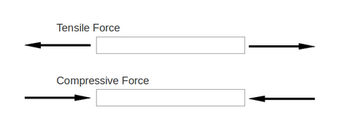
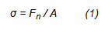
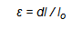
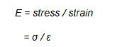
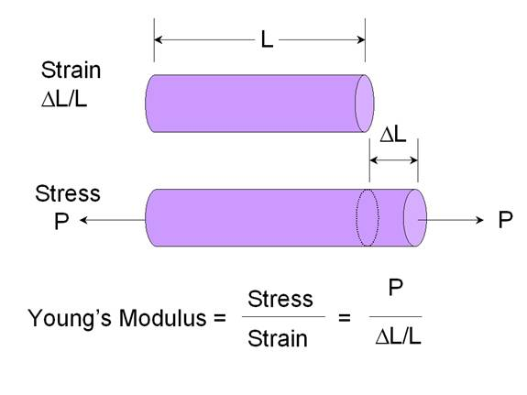
Stress
Strain
Elastic modulus

Slide 27
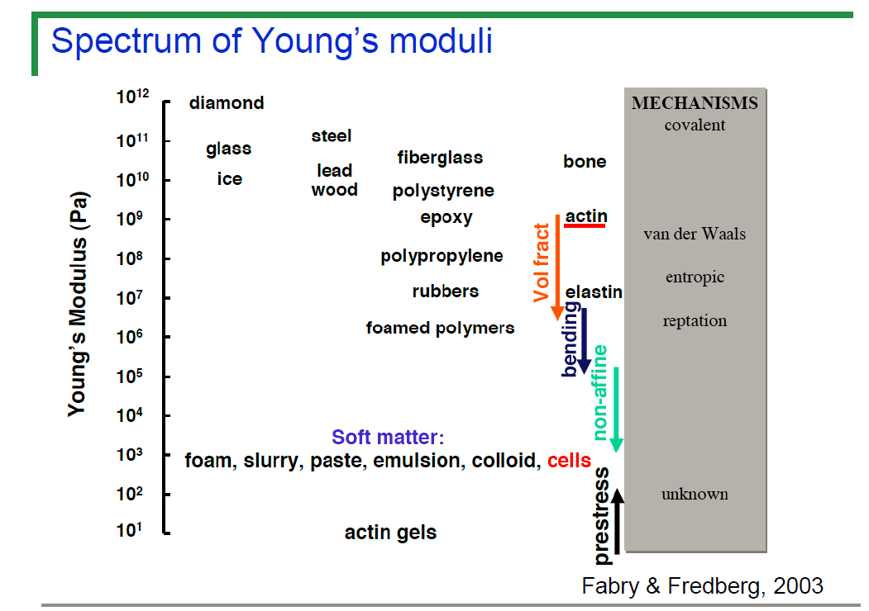

Slide 28
K_{B}: Bending stiffness
E: Young‘s modulus (elastic modulus)
I: Moment of inertia of the crosssection

Slide 29
Cytoskeleton consists of
- stiff rods
- flexible cables, where motor proteins act on.
Architectural design with these elements: Tensegrity.
( Tension + Integrity; Buckminster Fuller and Snelson).

Slide 30

Stiff, compressed
beams
Flexible, tensed
(longitudinally
stretched)
cables

Slide 31
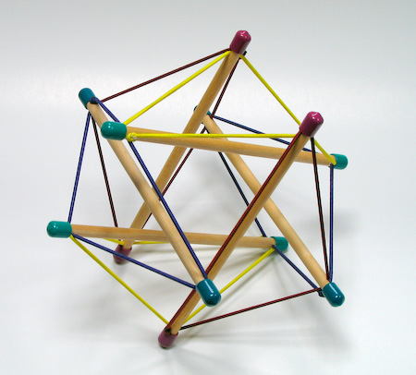
Tensegrity Structure

Slide 32
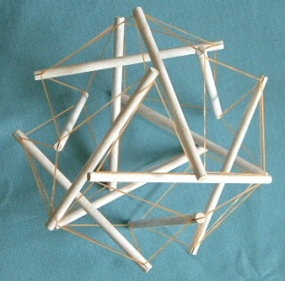
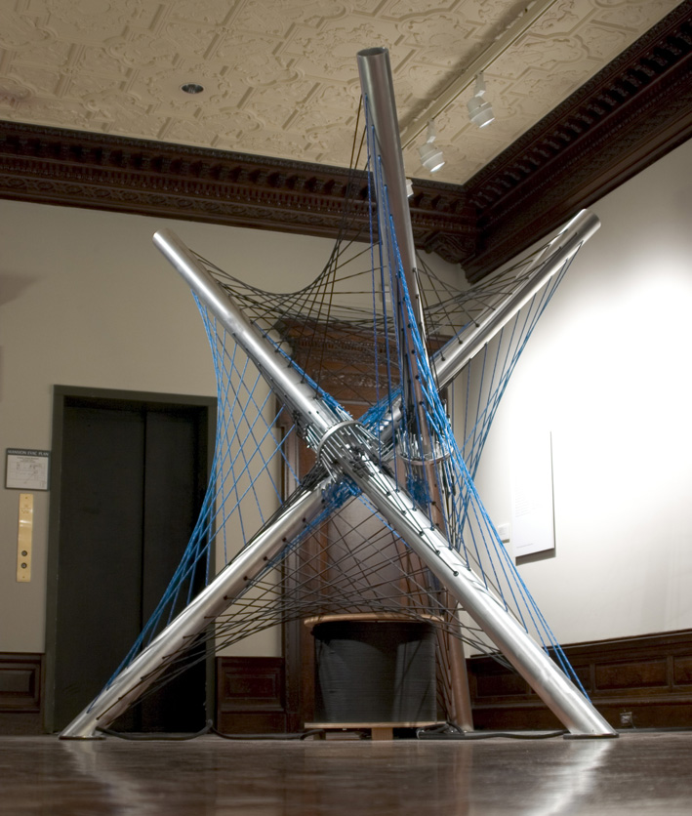
Theory of tensegrity proposes that a cell can be considered as a stable structure of struts and ropes
Controversial due to failure to consider dynamic properties of actin and tubulin.

Slide 33
Tensegrity & Buckling

Slide 34
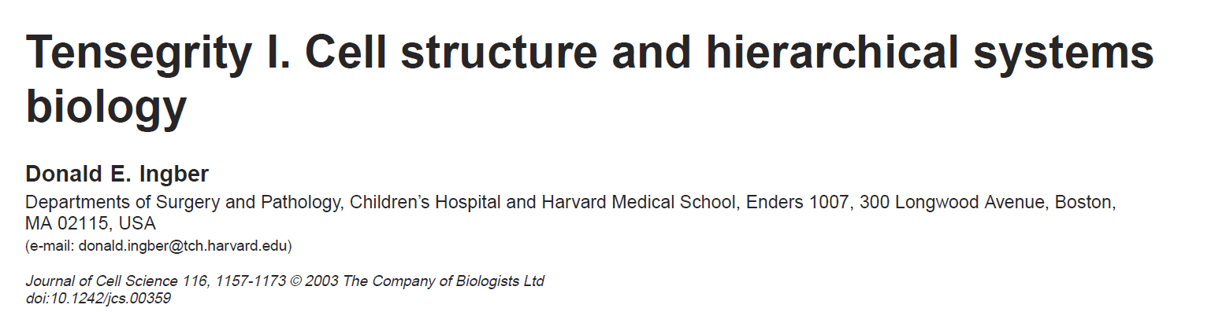
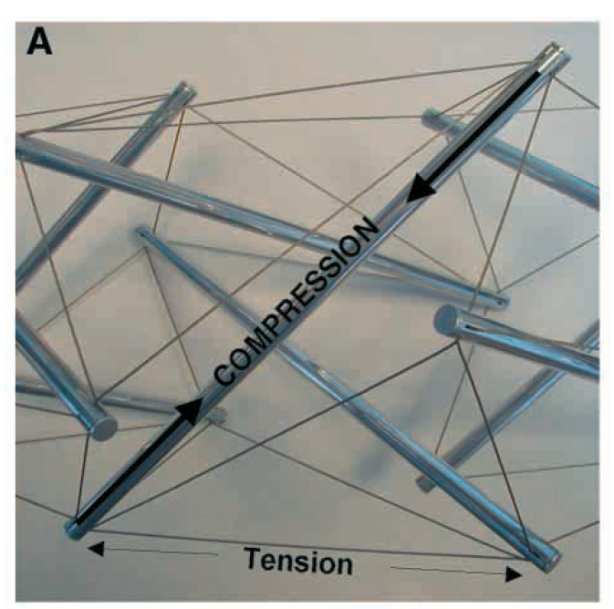
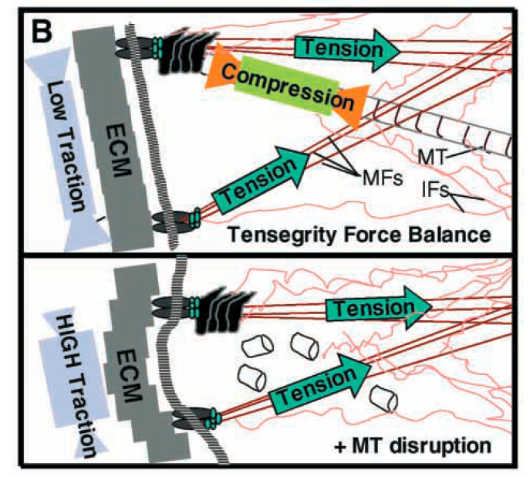

Slide 35
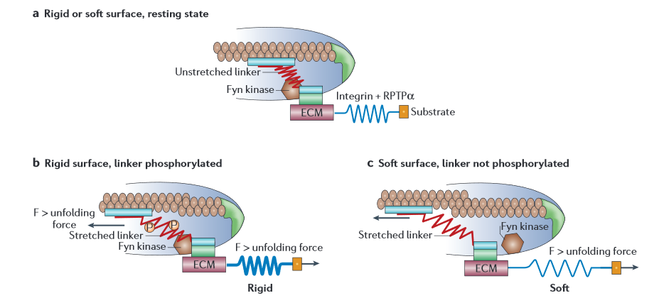
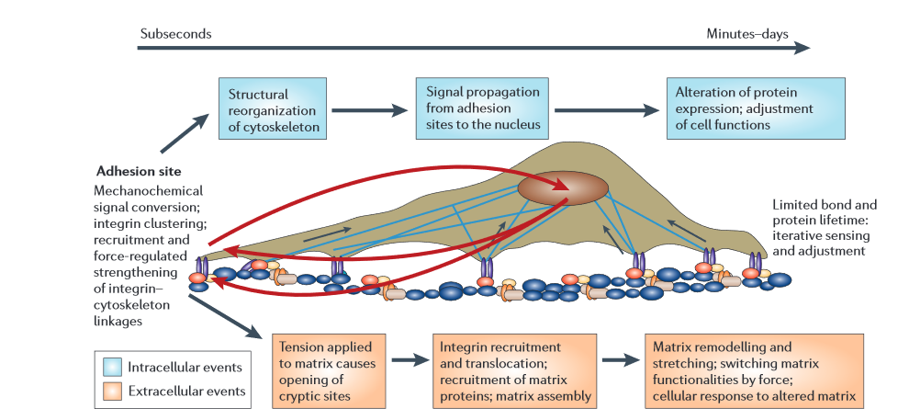

For mechanosensing, mechanics of the cell and cellular force generation are important.
Main cellular component conferring mechanical properties to cells: cytoskeleton.

Slide 36
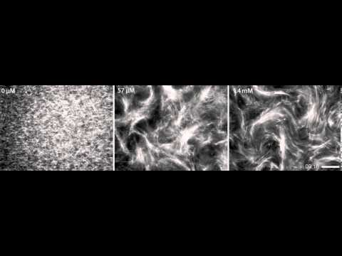
What happens with a microtubule under compression forces?
Microtubuli with different motor protein concentrations

Slide 37
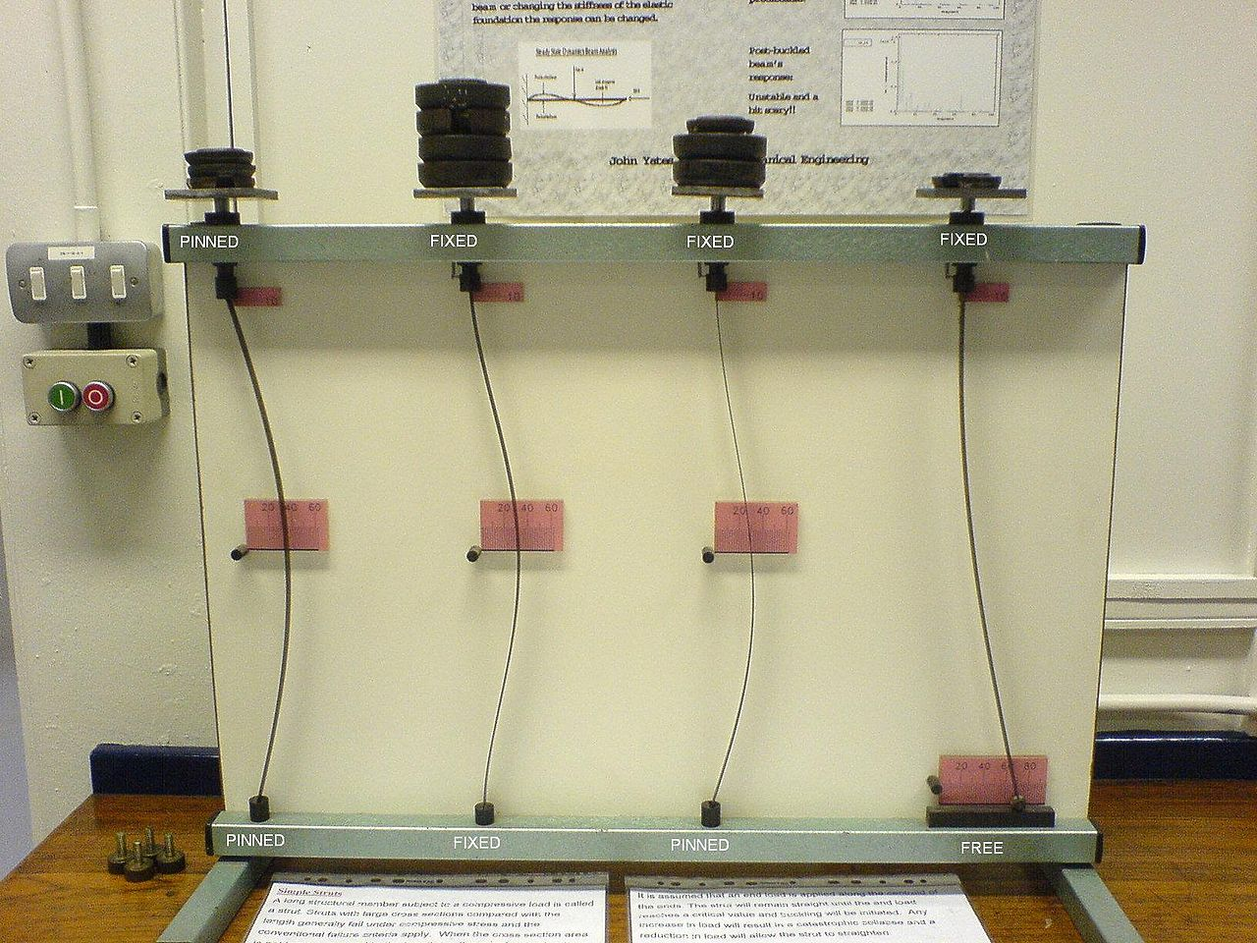
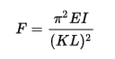
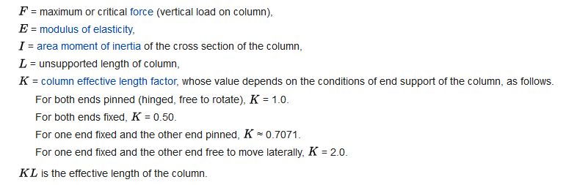
Buckling
Source: Wikipedia

Slide 38
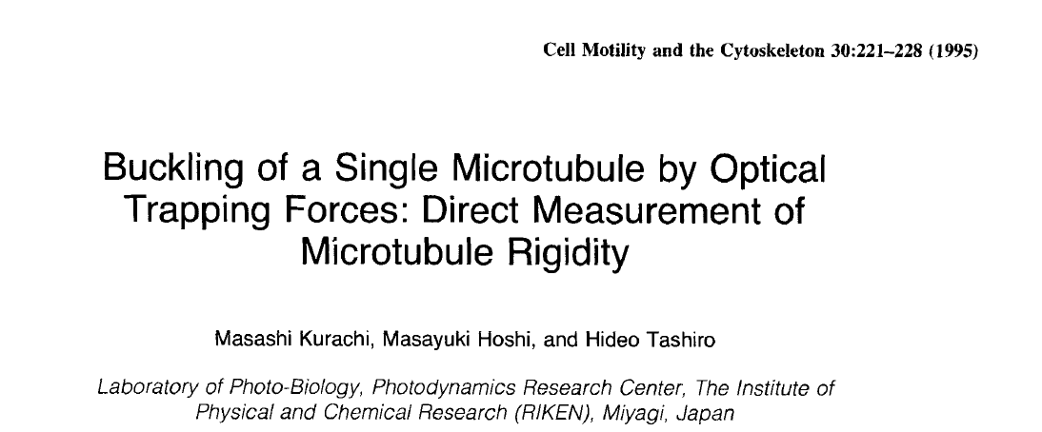

Slide 39
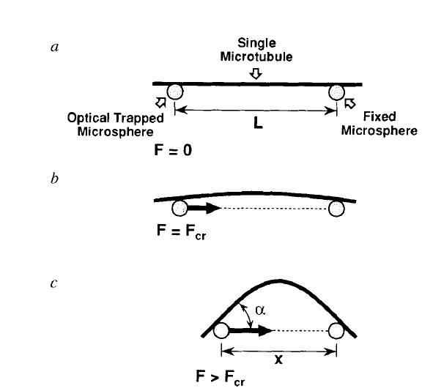
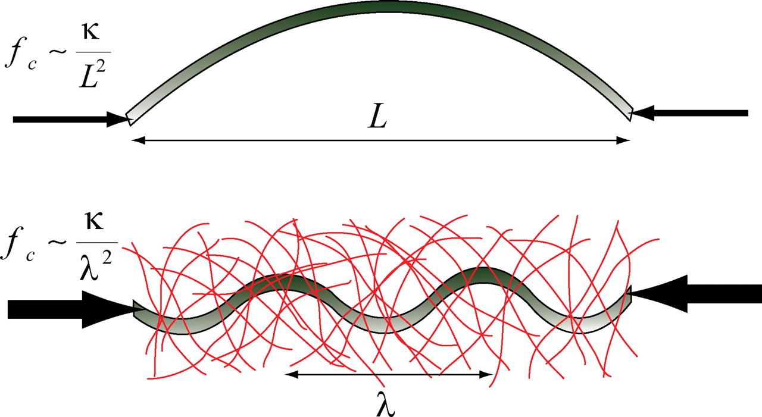
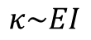
$$κ\sim EI$$

Slide 40
How does an optical trap work?

Slide 41
Key points
Light generates 2 types of optical forces: scattering, gradient
Trap strength depends on light intensity, gradient
Trap is harmonic: k ~ 0.1pN/nm

Slide 42
Optical scattering forces – reflection
ΔP
P_{f}
P_{i} = h/λ
θ
P_{i}
F = ΔP/Δt = (P_{f}-P_{i})/Δt
Newton’s third law – for every action there is an equal and opposite reaction
Notes:
Calculation of scattering force:
Impulse force F = dp/dt = 2p/dt. Really should be F = Qp/dt where Q is efficiency (Q ~ 0.1).
E = pc/n in medium of refractive index n. Thus, F = QnE/cdt = QnP/c, where P = power
F = QnP/c = 0.1*1.33*1e-3/3e8 ~ 0.5pN for 1mW of power

Slide 43
Optical forces – Refraction
P_{i}
P_{i}
ΔP
P_{f}

Slide 44
Lateral gradient force
Bright ray
Dim ray
Object feels a force toward brighter light
Notes:
Calculation of gradient force:
Force has same order of magnitude as scattering force: F = dp/dt = Qp/dt. Q will depend on how much bead will refract light
F = QnP/c = 0.1*1.33*1e-3/3e8 ~ 0.5pN for 1mW of power

Slide 45
Axial gradient force
ΔP
P_{i}
Focused
light
P_{f}
P_{i}
Object feels a force toward focus
Force ~ gradient intensity
Notes:
Leave it as exercise to show upstream bead is also attracted to focus.
Calculation of trap stiffness: force goes from max to zero over diffraction limited spot lambda/n.
K = F/(lambda/n) = Qn^2P/(c*lambda) = 0.1*1.33^2*1e-3/3e8/1000
~ 0.06pN/nm for 100mW of power (K ~ 0.1-1pN/nm typically)

Slide 46
2) Measurement
Want to measure forces, displacements – need to detect deflection of bead from trap center
1) Video microscopy
2) Laser-based method – Back-focal plane interferometry

Slide 47
Videos

Slide 48
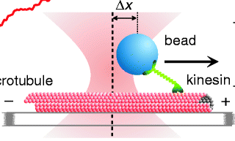
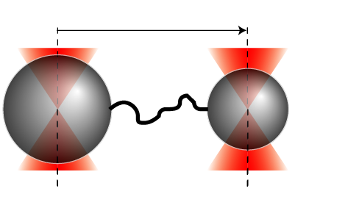
1) Manipulation
Want to apply forces – need ability to move stage or trap (piezo stage, steerable mirror, AOD…)
DNA

Slide 49
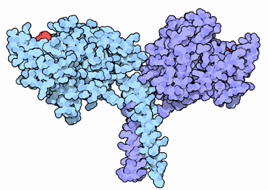
Observing individual steps
Motors move in discrete steps
Detailed statistics on kinetics of stepping & coordination
Kinesin
Step size: 8nm
Asbury, et al. Science (2003)

Slide 51
$$κ\sim EI$$

Slide 52
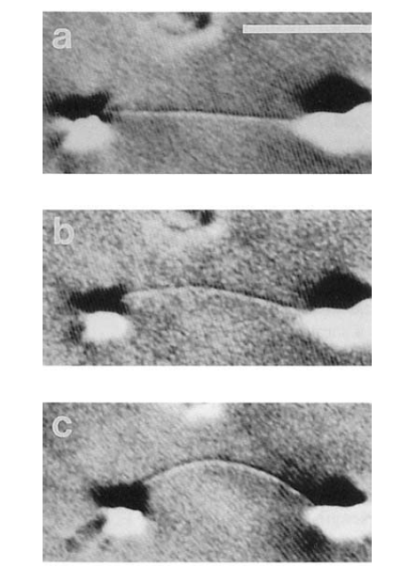
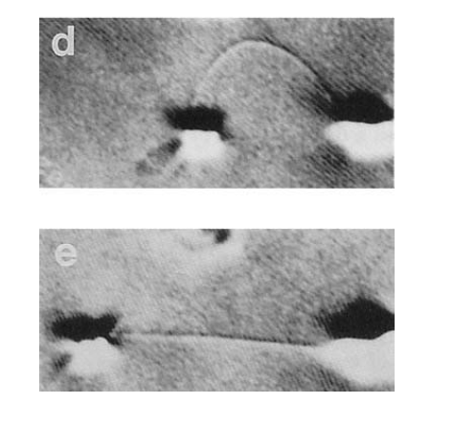

Slide 53
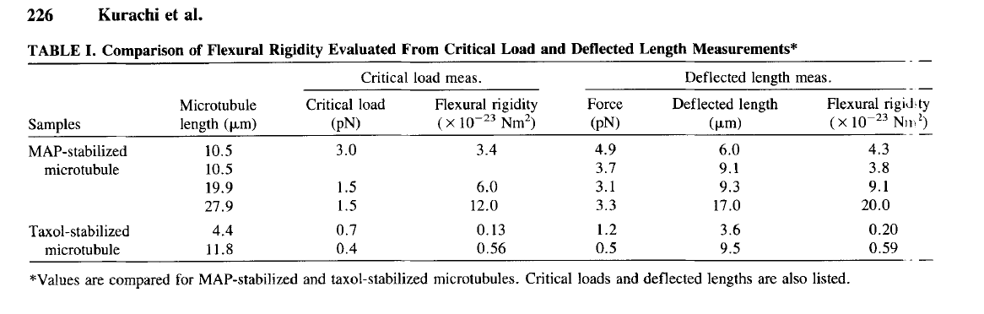
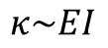
$$κ\sim EI$$

Slide 54
Microtubules can bear enhanced compressive loads in living cells because of lateral reinforcement
Clifford P. Brangwynne, Frederick C. MacKintosh, Sanjay Kumar, Nicholas A. Geisse, Jennifer Talbot, L. Mahadevan, Kevin K. Parker, Donald E. Ingber, and David A. Weitz
JCB
Volume 173(5):733-741
June 5, 2006
© 2006 Rockefeller University Press

Slide 55
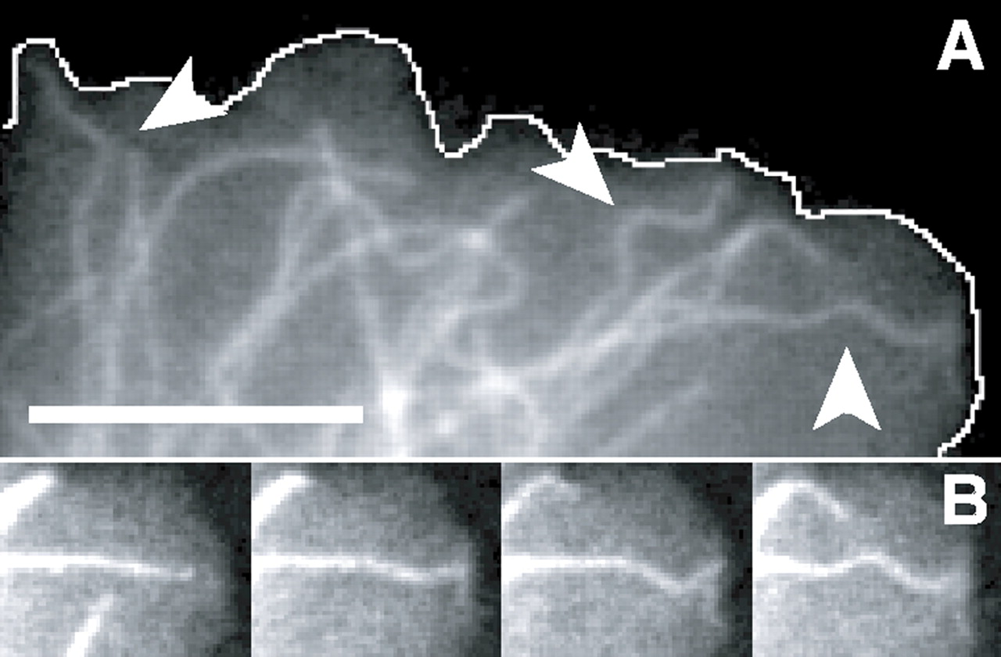
Structural dynamics of fluorescently labeled microtubules in living cells.
Clifford P. Brangwynne et al. J Cell Biol 2006;173:733-741
© 2006 Rockefeller University Press
Notes:
Structural dynamics of fluorescently labeled microtubules in living cells. (A) Fluorescence micrograph of a Cos7 cell expressing EGFP-labeled microtubules that frequently display sinusoidal shapes (arrowheads) at their ends, which is where they hit end-on at the cell periphery (white line indicates cell periphery). (B) Time sequence (left to right; 5 s between images) showing one microtubule from A at higher magnification as it buckles into a sinusoidal shape when it hits the cell edge (Video 1). Bar, 5 μm. Video 1 is available at http://www.jcb.org/cgi/content/full/jcb.200601060/DC1.

Slide 56
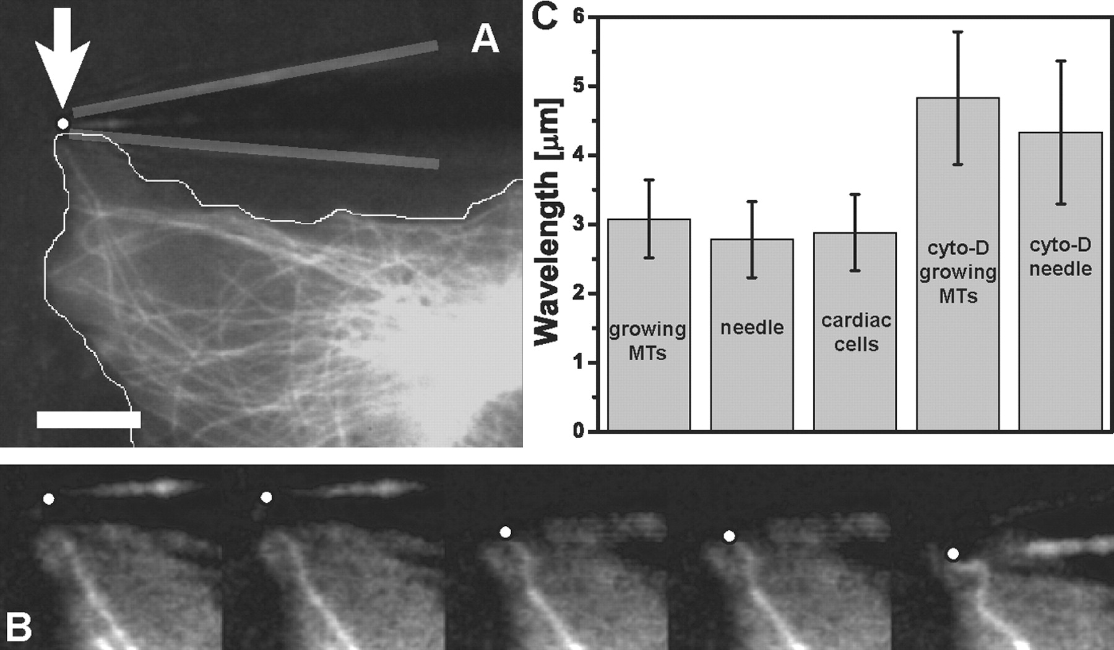
Deformation response of initially straight microtubules compressively loaded by a microneedle.
Clifford P. Brangwynne et al. J Cell Biol 2006;173:733-741
© 2006 Rockefeller University Press
Notes:
Deformation response of initially straight microtubules compressively loaded by a microneedle. (A) To determine if microtubules in cells buckle into short-wavelength shapes when artificially compressed by an exogenous force, we used a fine glass microneedle to push on initially straight microtubules at the cell periphery (white dot, needle tip position; gray lines, needle outline) Bar, 10 μm. (B) Time sequence of the microtubule in A compressed by the needle as it is moved from top to bottom (left to right; 1.1 s between images; Video 3). The microtubule buckles into a sinusoidal shape similar to that of naturally buckling microtubules. (C) The wavelength of microtubules buckled by the needle is the same as that of microtubules buckled as they polymerize into the cell cortex and that of microtubule buckling caused by actomyosin contractility in beating cardiac myocytes. When the actin cytoskeleton was disrupted in Cos7 cells treated with cytochalasin D, the wavelength of both naturally buckled and needle-buckled microtubules increased. MTs, microtubules. Error bars are ± SD. Video 3 is available at http://www.jcb.org/cgi/content/full/jcb.200601060/DC1.

Slide 57
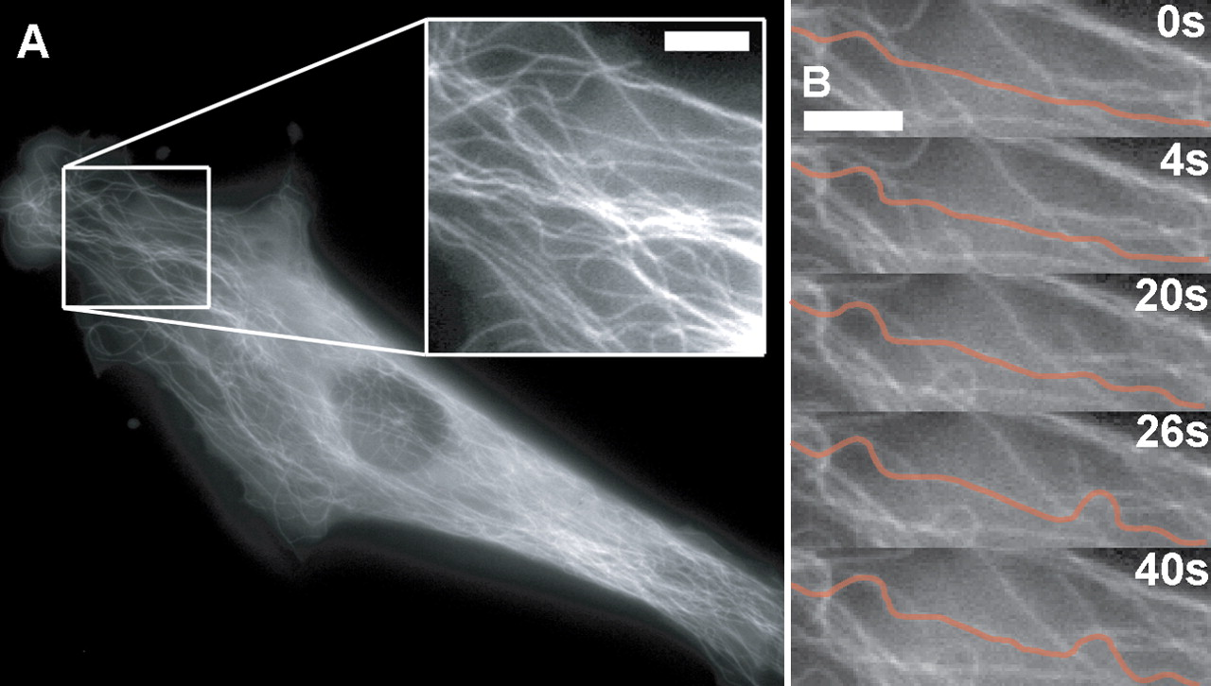
Microtubule buckling caused by cell contractility.
Clifford P. Brangwynne et al. J Cell Biol 2006;173:733-741
© 2006 Rockefeller University Press
Notes:
Microtubule buckling caused by cell contractility. (A) Fluorescence micrograph of a capillary cell expressing EGFP-tubulin and low and high (inset) magnification showing that microtubule buckling occurs throughout the cytoplasm with similar short-wavelength forms as observed at the periphery. (B) Time sequence of a movie of the cell shown in A, with a single microtubule highlighted in orange for clarity, demonstrated that high curvature buckling occurs in localized regions separated by straight regions of the same microtubule. Bars, 5 μm. Video 8. Video 8 is available at http://www.jcb.org/cgi/content/full/jcb.200601060/DC1.

Slide 58

Periodic microtubule buckling caused by contractile beating of heart cells.
Clifford P. Brangwynne et al. J Cell Biol 2006;173:733-741
© 2006 Rockefeller University Press
Notes:
Periodic microtubule buckling caused by contractile beating of heart cells. (A) Time sequence of a microtubule buckling in a beating cardiac myocyte. The microtubule can be seen to buckle and unbuckle successively three times (Video 5). (B) Time sequence of a microtubule buckling and unbuckling in a beating cardiac myocyte, while neighboring microtubules remain straight. The microtubule buckles in a specific spot in each of the successive buckling events (Video 6). (C) Fourier mode analysis of the microtubule shown in B demonstrates that the amplitude of the bending on wavelengths of ∼3 μm shows periodic spikes caused by periodic buckling of the microtubule under successive contractile beats. The amplitude of this periodic buckling decreases with time as the intensity of the contractile force decreases with time because of photodamage. Bars, 3 μm. Videos 5 and 6 are available at http://www.jcb.org/cgi/content/full/jcb.200601060/DC1.

Slide 59

Macroscopic buckling with a plastic rod.
Clifford P. Brangwynne et al. J Cell Biol 2006;173:733-741
© 2006 Rockefeller University Press
Notes:
Macroscopic buckling with a plastic rod. (A) When a thin (∼0.2-mm-diam) plastic rod was compressed in a 1-cm-wide rectangular chamber filled with water it underwent classic long-wavelength Euler buckling. (B) When this experiment was repeated with a rod embedded in an elastic gelatin network, short wavelength buckling (λ = 1.1 cm) was observed. (C) A local region of the gelatin network was first disrupted by overcompression of the rod. When the rod was subsequently released and then compressed again, local short-wavelength buckling was limited to this same disrupted region, even while the rest of the rod remained straight. (D) When this experiment was repeated with plastic rods of differing stiffness, there was good agreement with theory in all cases (top right data points). The data from microtubules buckled because of exogenous forces, polymerization forces, and actomyosin contractile forces also show good agreement with this theory (bottom left data points). Vertical error bars are ± SD. Horizontal error bars (bottom left cell MT data) are an estimate of the uncertainty in MT bending rigidity.

Slide 60

Decay of transmission of the compressive force.
Clifford P. Brangwynne et al. J Cell Biol 2006;173:733-741
© 2006 Rockefeller University Press
Notes:
Decay of transmission of the compressive force. (A) In microtubules compressed by force application at their tips (Figs. 1 and 2), the buckling amplitude decays along the length of the microtubule, reflecting an attenuation of the compressive force by the surrounding network. (B) Similar behavior was seen in the macroscopic experiments using plastic rods embedded in elastic gelatin.

Slide 61
Schematic summarizing how the presence of the surrounding elastic cytoskeleton reinforces microtubules in living cells.
Clifford P. Brangwynne et al. J Cell Biol 2006;173:733-741
© 2006 Rockefeller University Press
Notes:
Schematic summarizing how the presence of the surrounding elastic cytoskeleton reinforces microtubules in living cells. Free microtubules in vitro buckle on the large length scale of the filament, at a small critical buckling force. Microtubules in living cells are surrounded by a reinforcing cytoskeleton. This leads to a larger critical force, and buckling on a short wavelength.

Slide 62

What is the mechanical effect of crosslinking
Distinct actin filament organizations and their mechanical description.
Plasticity on long time scales/under force
Laurent Blanchoin et al. Physiol Rev 2014;94:235-263
©2014 by American Physiological Society
Notes:
Distinct actin filament organizations and their mechanical description. A: a branched actin network results from the autocatalytic branching activity of the Arp2/3 complex. Activated by nucleation promoting factors, NPFs, the Arp2/3 complex generates a branched network from the side of a preexisting actin filament, called a “primer.” In the presence of capping proteins (+CP), branches are shorter. This yields dense and rigid subnetworks that evolve into an entangled meshwork. The entanglement of filament subnetworks leads to mechanical interactions that are represented by a spring (in red) connecting barycenters (spheres) of adjacent subnetworks. In the absence of capping proteins (−CP), actin filaments grow longer and can either align into an antiparallel organization or bend and coalesce into a parallel bundle. These parallel filaments form stable filopodia-like bundles that act as a solid body. B: long crosslinkers organize actin filaments into networks. These bonds act as rigid links and control the global elasticity of the actin network depending on their binding kinetics and concentration. C: short crosslinkers tightly pack unbranched filaments, such as those generated by formins or Ena/VASP proteins, into stiff, straight bundles. D: molecular motors, myosins, are dynamic links that gather antiparallel filaments into a contractile unit. They act as active springs. On the right, gray diagrams represent mechanical analogs of each molecular structure.

Slide 63

Networks are interconnected: composite material!

Slide 64

Microtubuli form interconnected networks in axons.

Slide 65

Networks of neighboring cells can be interconnected

Slide 66


Slide 67


Slide 68


Slide 69


Slide 70


Slide 71


Slide 72
Aim: measure the mechanical response of a crosslinked actin network
Approach: Magnetic chaining

Slide 73



Slide 74



Color of scattered light depends on distance between colloidal super-paramagnetic beads

Slide 75

Modulating external Field B_{e} modulates bead distance

Slide 76

Distance is result of equilibrium of repulsive and attractive forces
Distance d between beads is measured using spectrometer or directly with videomicroscopy
can be estimated from d
Can be adjusted by altering external magnetic field B_{e}
Calculating repulsive force between beads allows measurements of force-distance relationship of polymers on beads

Slide 77

Experimental Setup

Slide 78

Arp2/3 activating protein (VAP domaine of N-WASP)
Arp2/3
Actin
Variation of Arp2/3 concentration;
of capping protein concentration
Colloidal superparamagnetic bead

Slide 79







Measurement of Force/Distance Profile reveals Youngs Modulus
http://de.academic.ru/pictures/dewiki/75/Kontakt_Kugel_Ebene.jpg
Indentation Force
Indentation Depth
Young Modulus
R:
Sphere Radius
Homogeneous elastic half-space
No Adhesion

Slide 80


Nearly linear dependency of E on crosslinker concentration

Slide 81
Deformation in these dense networks dominated by enthalpic bending
E: Young‘s Modulus; ζ: mesh size; L: characteristic length (correlated to crosslinker distance); a: size of actin monomer

Slide 82


Slide 83


Rheology by AFM

Slide 84


Slide 85


